Slide 1
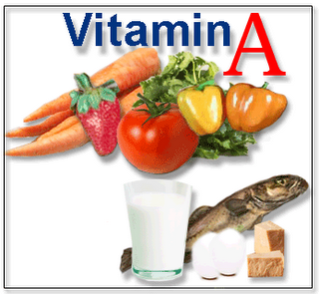
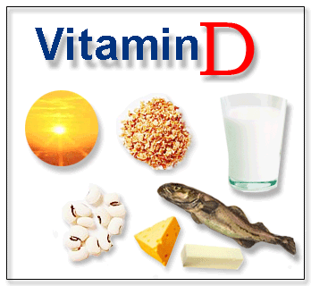
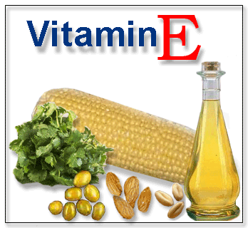
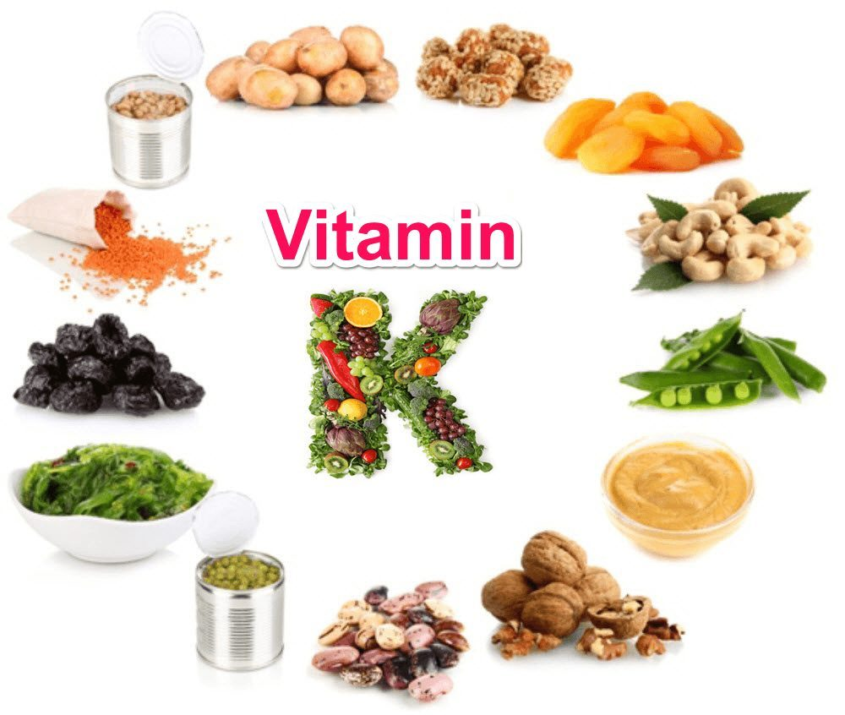
NUTRIENT IMBALANCE Part 1 FAT SOLUBLE VITAMINS

Slide 2
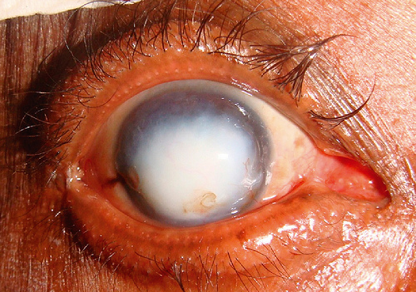
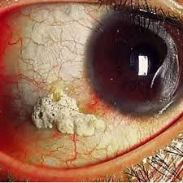
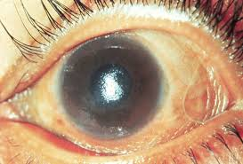

DEFICIENCY OF VITAMIN A (Retinoids)
VITAMIN A is a natural Antioxidant
Dry Skin
Night Blindness
Xeropthalmia
Bitot Spots
Keratomalacia
Infertility
Delayed growth
Frequent Infections
Poor Wound Healing
Bitot Spots
Keratomalacia
Xeropthalmia
Dry Skin

Slide 3



Excess Vitamin A leads to :
Drowsiness
Hypervitaminosis A:
Drowsiness
Irritability
Headache
Nausea
Vomiting
Headache
Nausea

Slide 4

Find your answer
Which is the leading cause of blindness in children worldwide?
(a) Glaucoma
(b) Cataracts
(c) Colour blindness
(d) Vitamin A deficiency
Which of the following vitamin functions as both, hormone and visual pigment?
(a) Thiamine
(b) Retinal
(c) Riboflavin
(d) Folic acid
Vitamin A was discovered in which year?
1910
1912
1922
1927

Slide 5

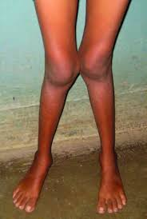
Deficiency of Vitamin D (Cholecalciferol)
A condition of soft and tender bones with less calcium absorption
RICKETS (Children)
OSTEOMALACIA (Adults)

Slide 6
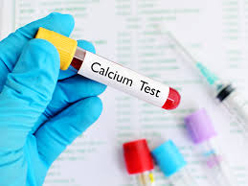
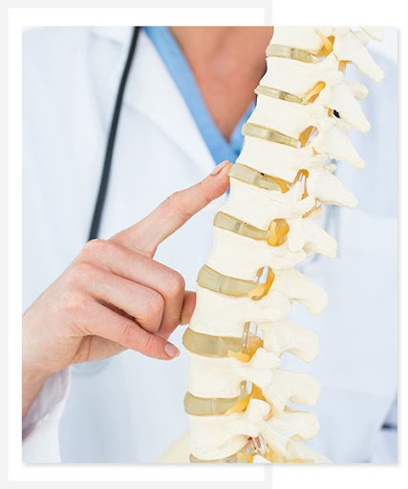

Excess Vitamin D leads to:
Hypercalcemia (Increased calcium in the bones)
Hypervitaminosis D
Nausea and Vomiting
Hyper calcification of Bones and Teeth
Hardening of arteries and soft tissue
Pain in joint and muscle
Hypercalciuria (increases urinary calcium)
Hyperphosphatemia (increased phosphorus in bones)

Slide 7
Find your answer
Which of the following vitamins serves as a hormone precursor?
(a) Vitamin A
(b) Vitamin C
(c) Vitamin D
(d) Vitamin K
Which of the following is not a function of vitamin D?
a) Lipid-soluble antioxidant in cell membranes
b) Fast responses to increase calcium absorption with no change in gene expression
c) Slow responses to increase calcium absorption
d) Regulation of bone turnover

Slide 8



Deficiency of Vitamin E (Tocopherol)
Signs and Symptoms
Nerve and muscle damage
Numbness in the arms and legs
Loss of body movement control
Muscle weakness, and vision problems
Weakened immune system
Weakened immune system
Numbness
VITAMIN E is a natural Antioxidant
Muscle weakness

Slide 9
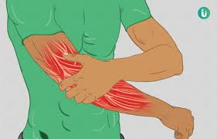


EXCESS OF VITAMIN E LEADS TO:
Muscle weakness
Signs and Symptoms
Risk of bleeding
Fatigue
Muscle weakness
Nausea and vomiting
Diarrhea
Blurred vision.
Nausea and vomiting
Blurred vision

Slide 10
Find your answer
Weakness in muscles and increase in the fragility of red blood cells is caused due to the __________.
(a) Deficiency of vitamin E
(b) Deficiency of vitamin D
(c) Deficiency of vitamin C
(d) Deficiency of vitamin A
Which vitamin is a major lipid-soluble antioxidant in cell membranes?
a) Vitamin A
b) Vitamin D
c) Vitamin E
d) Vitamin K

Slide 11
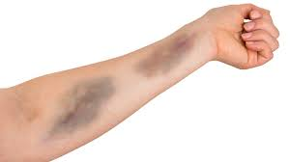
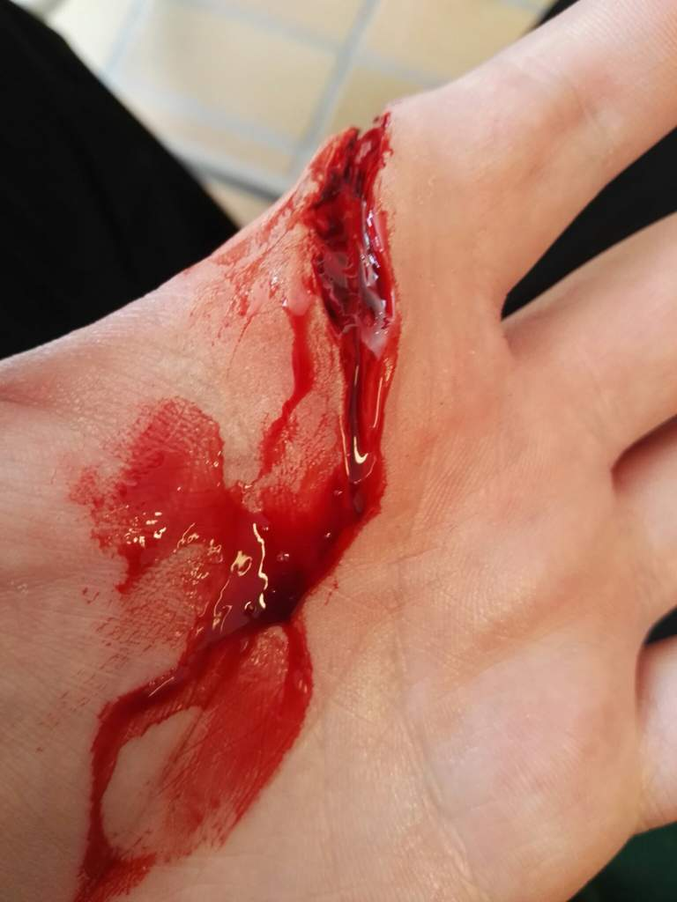
Deficiency of Vitamin K (Phylloquinone)
Signs and Symptoms
Bruising
Hemorrhage - Significant bleeding
Poor bone development
Osteoporosis
Increased cardiovascular disease
Bruising
Excess of Vitamin K leads to:
Significant bleeding
Signs and Symptoms
Improper functioning of gastro intestinal tract
Jaundice in newborns
Anemia due to rupture of red blood cells
Hyperbilirubinemia

Slide 12
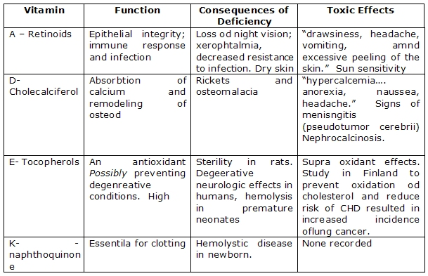
Overview of fat soluble vitamins

Slide 13
Find your answer
Toxicity of what vitamin causes: Augments the effects of anti-clotting medications, general discomfort, nausea, blurred vision and fatigue?
a) Vitamin A
b) Vitamin C
c) Vitamin E
d) Vitamin K
Which of the following is not the function of vitamins
Helping in the absorption of calcium for healthy bones
Protecting your cells from free radicals.
Aiding in blood clotting.
Providing energy in the form of glucose.

Slide 14
REFERENCE BOOKS
Food Science- Srilakshmi, Prosper Montague Publishing Group Ltd., Hamlyn, London. 2003.
Food & Nutrition- Swaminathan, The Bangalore Printing & publishing co ltd., Vol I, Second Edition, Bangalore (1995).
An Introduction to Lifestyle Management: Facilitator’s Handbook, Dr.Anja Morris-Paxton, 2019
DEVELOPED RESOURCE MATERIALS
Fat Soluble Vitamins Developed PDF attached in Ample course content
LOCAL VIDEO DEVELOPED:
https://youtu.be/FmafhSMv0e0 - Video link is available in Ample course content

Slide 15

EAT MORE FRUITS AND VEGETABLES

